Slide 1
Linear Regression

Slide 2
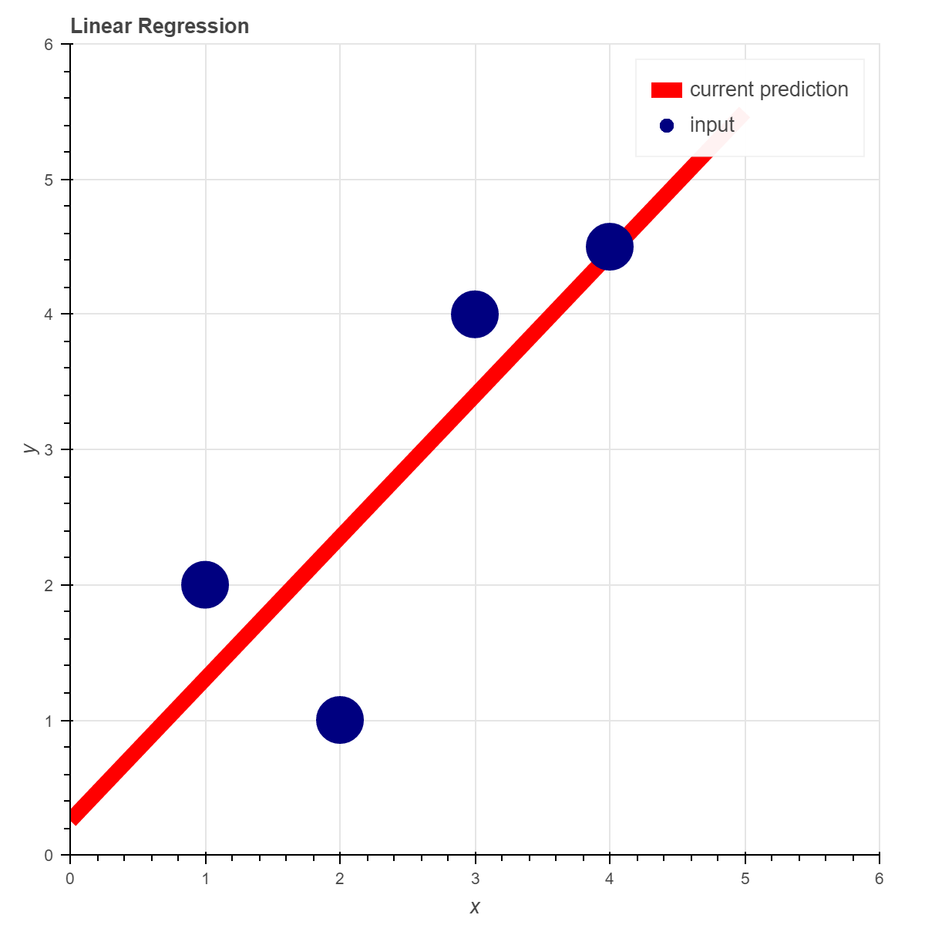
Linear Regression
Linear Regression attempts to model the relationship between a scalar output value (y) and one or more input variables (X)
The function of a line is one model that can be used:
y = mX + b
We would “learn” by adjusting our ‘m’ and ‘b’ variables so that the line best matches the input data.

Slide 3
Linear Regression
Three steps for learning:
Take a guess – Our guess will be defined as a heuristic formula.
Evaluate our best guess – We will define a cost function that will tell us how far away our heuristic is from giving the correct answer(s).
Adjust our best guess – We will use a technique called gradient descent to adjust our heuristic in a manner that will cause our cost function to return the lowest error possible.

Slide 4
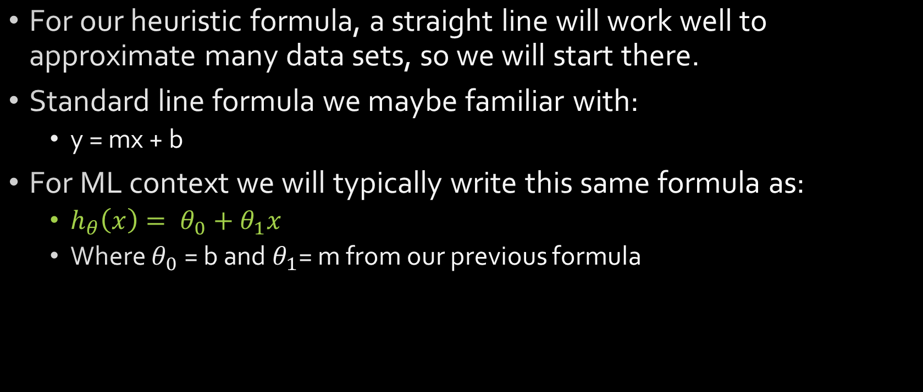
Linear Regression Heuristic
For our heuristic formula, a straight line will work well to approximate many data sets, so we will start there.
Standard line formula we maybe familiar with:
y = mx + b
For ML context we will typically write this same formula as:
$h_{θ}\left(x\right)= θ_{0}+θ_{1}x$
Where $θ_{0}$ = b and $θ_{1}$= m from our previous formula

Slide 5
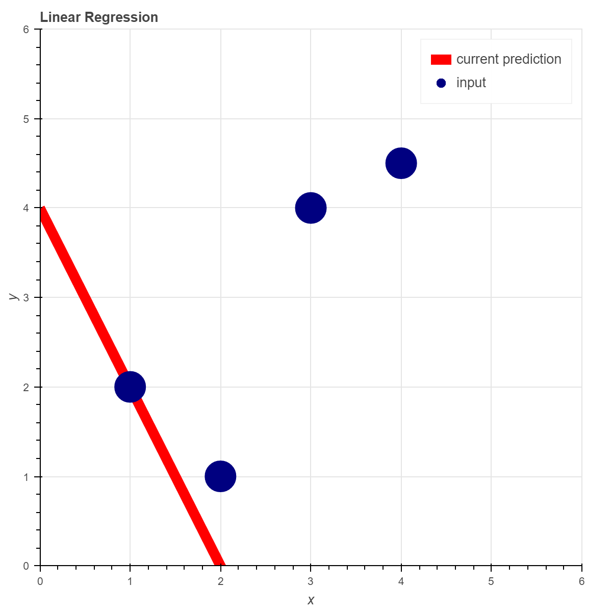
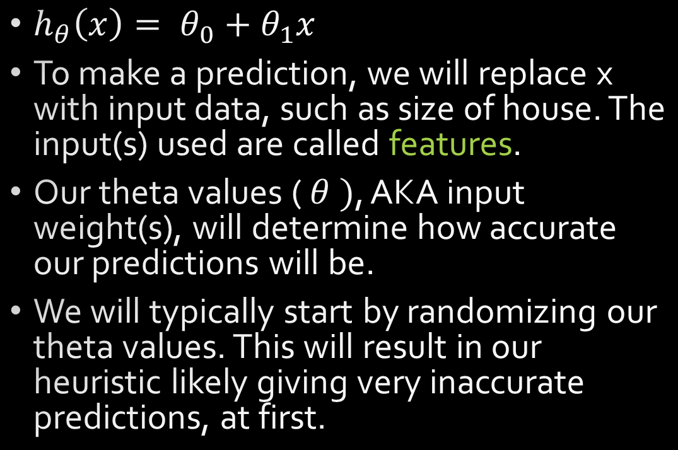
Linear Regression Heuristic
$h_{θ}\left(x\right)= θ_{0}+θ_{1}x$
To make a prediction, we will replace x with input data, such as size of house. The input(s) used are called features.
Our theta values ( $θ )$, AKA input weight(s), will determine how accurate our predictions will be.
We will typically start by randomizing our theta values. This will result in our heuristic likely giving very inaccurate predictions, at first.

Slide 6
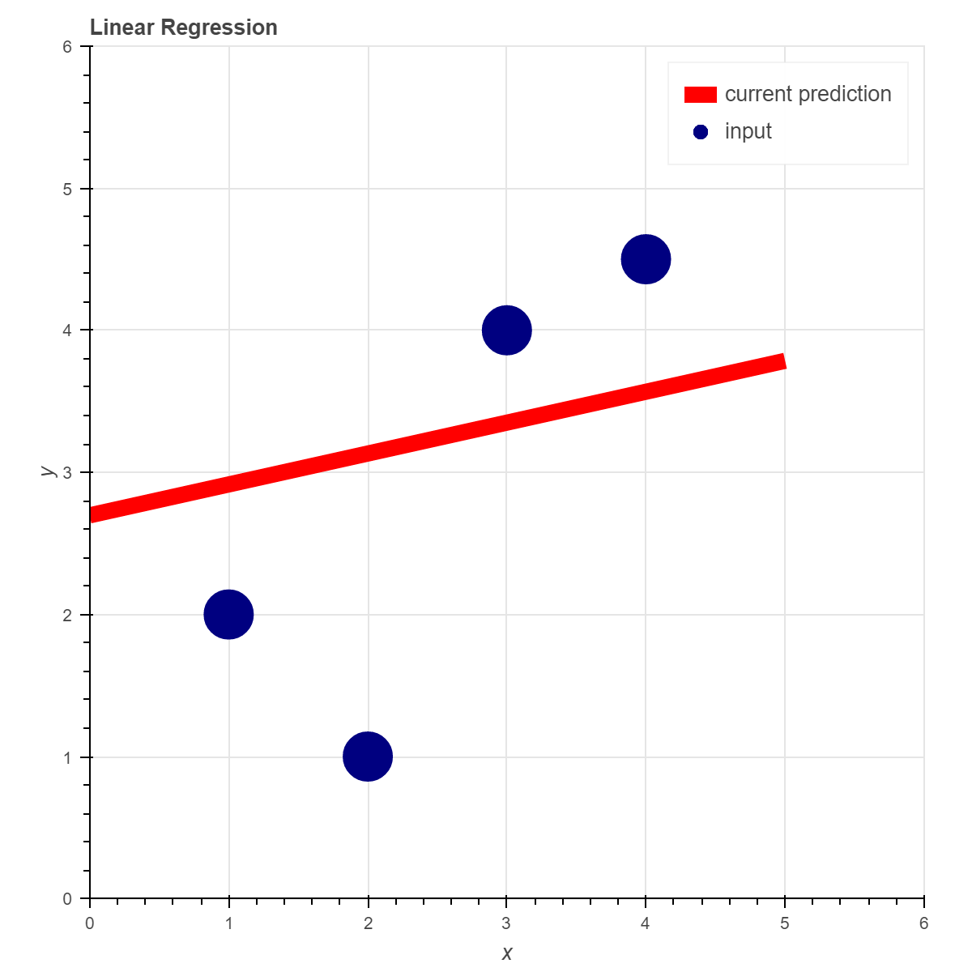
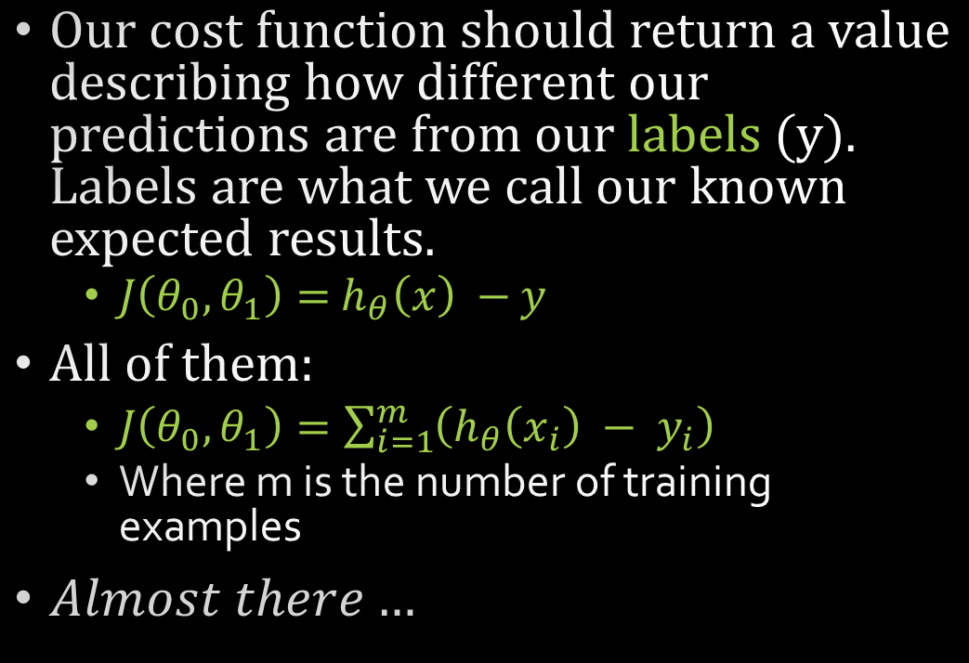


Linear Regression Cost Function
Our cost function should return a value describing how different our predictions are from our labels (y). Labels are what we call our known expected results.
$J\left(θ_{0},θ_{1}\right)=$ $h_{θ}\left(x\right) −$ $y$
All of them:
$J\left(θ_{0},θ_{1}\right)=\sum_{i=1}^{m}{\left(h_{θ}\left(x_{i}\right) − y_{i}\right)}$
Where m is the number of training examples
$Almost there…$
$$h_{θ}(X_{2})$$
$$y_{2}$$

Slide 7
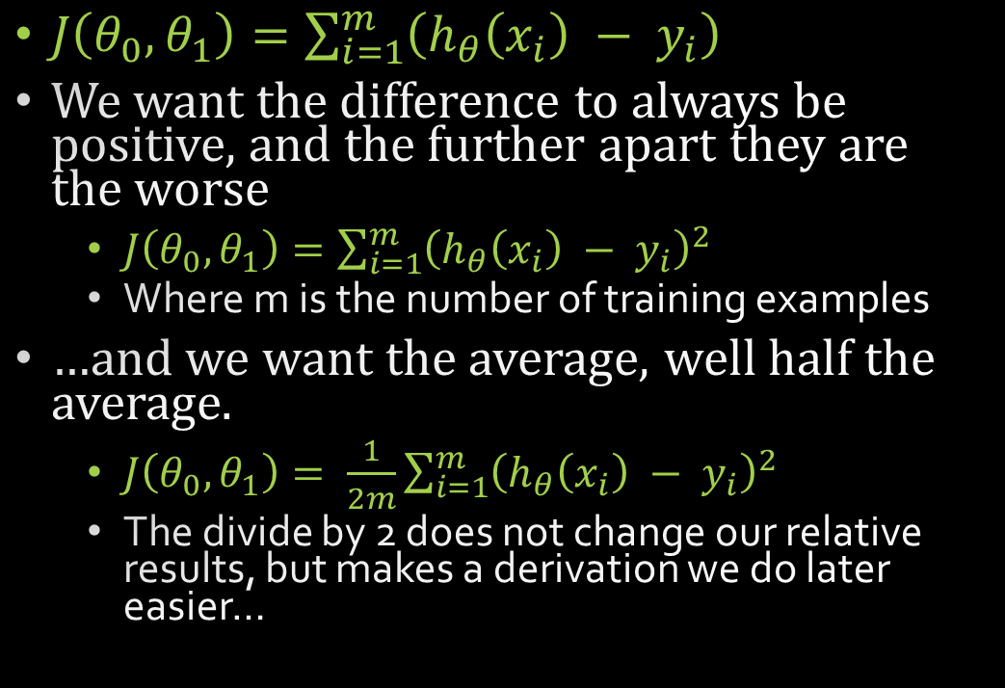
Linear Regression Cost Function
$J\left(θ_{0},θ_{1}\right)=\sum_{i=1}^{m}{\left(h_{θ}\left(x_{i}\right) − y_{i}\right)}$
We want the difference to always be positive, and the further apart they are the worse
$J\left(θ_{0},θ_{1}\right)=\sum_{i=1}^{m}{{\left(h_{θ}\left(x_{i}\right) − y_{i}\right)}^{2}}$
Where m is the number of training examples
…and we want the average, well half the average.
$J\left(θ_{0},θ_{1}\right)= \frac{1}{2m}\sum_{i=1}^{m}{{\left(h_{θ}\left(x_{i}\right) − y_{i}\right)}^{2}}$
The divide by 2 does not change our relative results, but makes a derivation we do later easier…
$$h_{θ}(X_{2})$$
$$y_{2}$$

Slide 8

Linear Cost Pseudo-code
$J\left(θ_{0},θ_{1}\right)= \frac{1}{2m}\sum_{i=1}^{m}{{\left(h_{θ}\left(x_{i}\right) − y_{i}\right)}^{2}}$
for each feature (there are $m$ number of features)
featureError = linearHeuristic(currentFeature) – currentLabel
runningTotal += featureError * featureError
cost = runningTotal / 2 * numFeatures

Slide 9
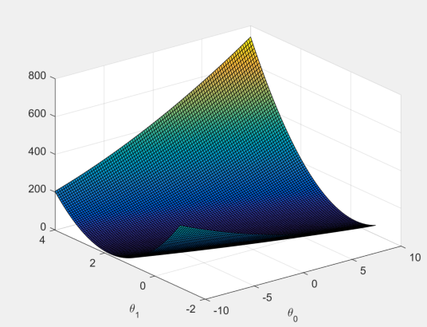
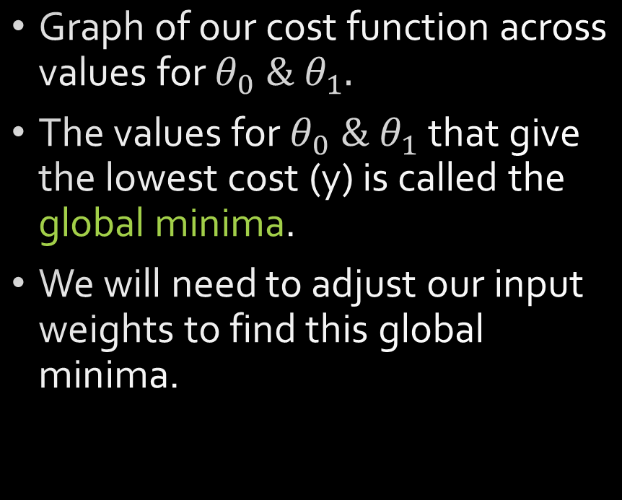
Linear Regression Cost Function
Graph of our cost function across values for $θ_{0} \& θ_{1}.$
The values for $θ_{0} \& θ_{1}$ that give the lowest cost (y) is called the global minima.
We will need to adjust our input weights to find this global minima.
y

Slide 10


Linear Regression- adjusting our guess
We could just set values for our input weights randomly until we find a low cost, but this approach is likely to give poor results and take a very long time to get any sort of good answer.
Each of our input weights, $θ_{0},θ_{1}$, are linear values. If only we knew which direction to adjust them in so as to reduce our cost function result…

Slide 11
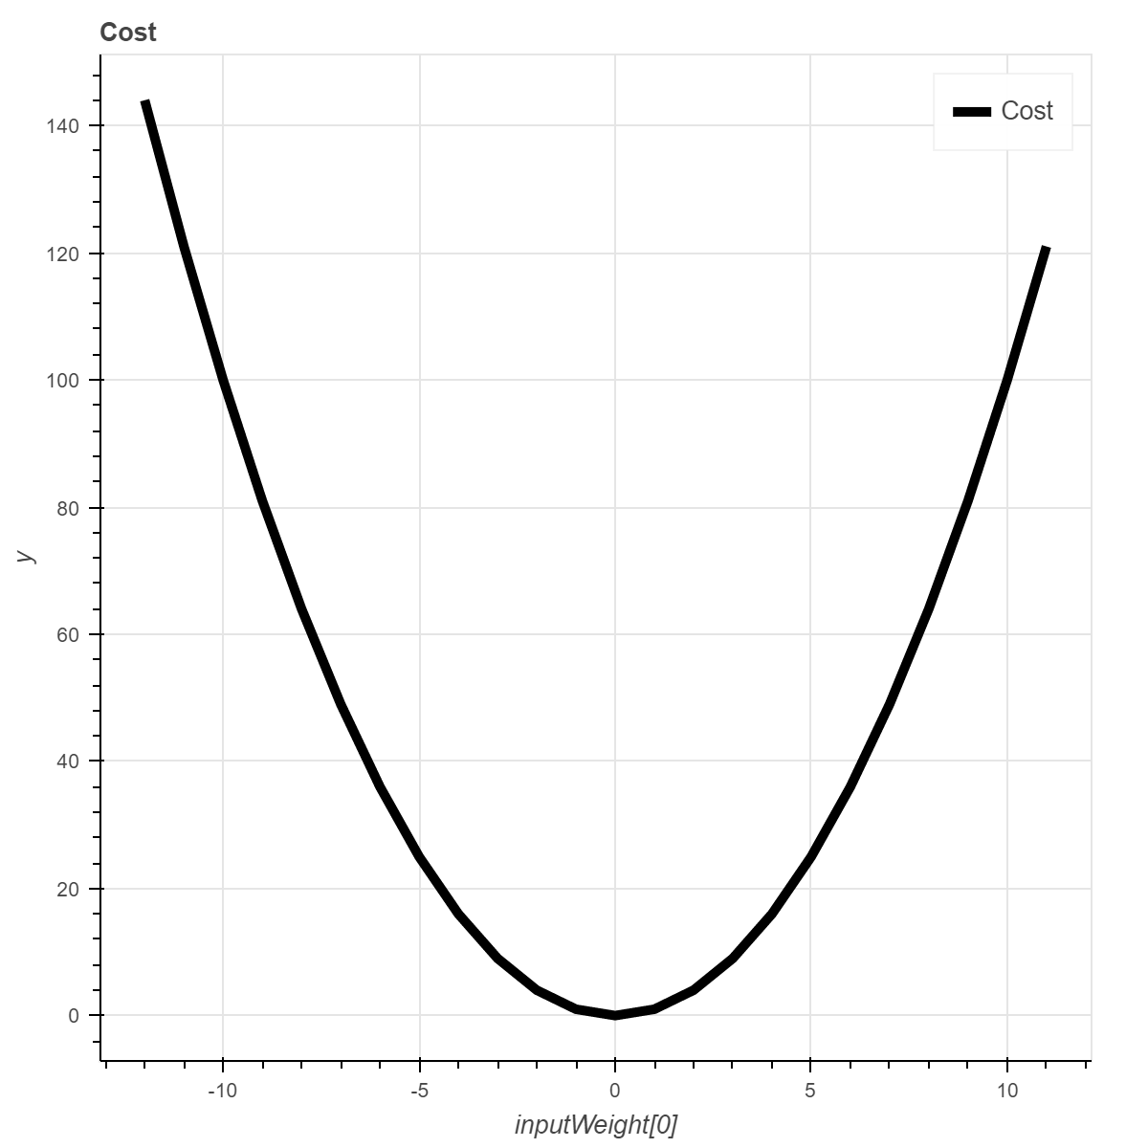


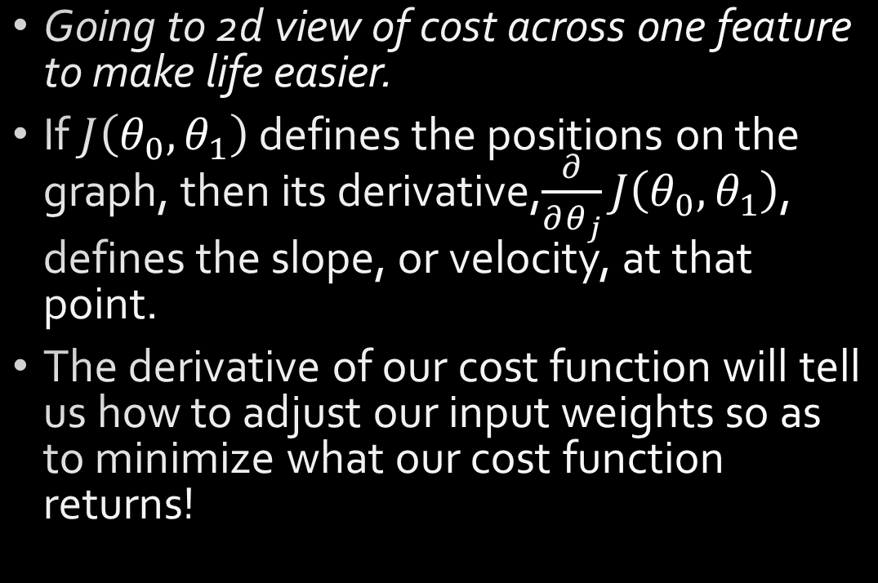
Linear Regression – This looks like a job for Calculus!
Going to 2d view of cost across one feature to make life easier.
If $J\left(θ_{0},θ_{1}\right)$ defines the positions on the graph, then its derivative,$\frac{∂}{∂θ_{j}}J\left(θ_{0},θ_{1}\right)$, defines the slope, or velocity, at that point.
The derivative of our cost function will tell us how to adjust our input weights so as to minimize what our cost function returns!
$$J\left(−10,θ_{1}\right)$$
$$\frac{∂}{∂θ_{j}}J\left(−10,θ_{1}\right)$$

Slide 12


Linear Regression – adjusting our guess
Calculating $\frac{∂}{∂θ_{j}}J\left(θ_{0},θ_{1}\right)$ is outside our focus, so I will just give the result.
$j=0:$
$\frac{∂}{∂θ_{j}}J\left(θ_{0},θ_{1}\right)= \frac{1}{m}\sum_{i=1}^{m}{\left(h_{θ}\left(x_{i}\right) − y_{i}\right)}$
$j=1:$
$\frac{∂}{∂θ_{j}}J\left(θ_{0},θ_{1}\right)= \frac{1}{m}\sum_{i=1}^{m}{\left(h_{θ}\left(x_{i}\right) − y_{i}\right)} ∗x_{i}$
$$J\left(−10,θ_{1}\right)$$
$$\frac{∂}{∂θ_{j}}J\left(θ_{0},θ_{1}\right)$$

Slide 13

Partial derivative of cost pseudo-code
$\frac{∂}{∂θ_{j}}J\left(θ_{0},θ_{1}\right)= \frac{1}{m}\sum_{i=1}^{m}{\left(h_{θ}\left(x_{i}\right) − y_{i}\right)} ∗x_{i}$ where $x_{0}=1$
for each feature (there are $m$ number of features)
featureError = linearHeuristic(currentFeature) – currentLabel
for numInputs (range of $j$)
runningTotal[currentInput] += featureError * currentFeature[currentInput]($x_{i}$)
for numInputs
resultingChange[currentInput] = runningTotal[currentInput] / numFeatures

Slide 14
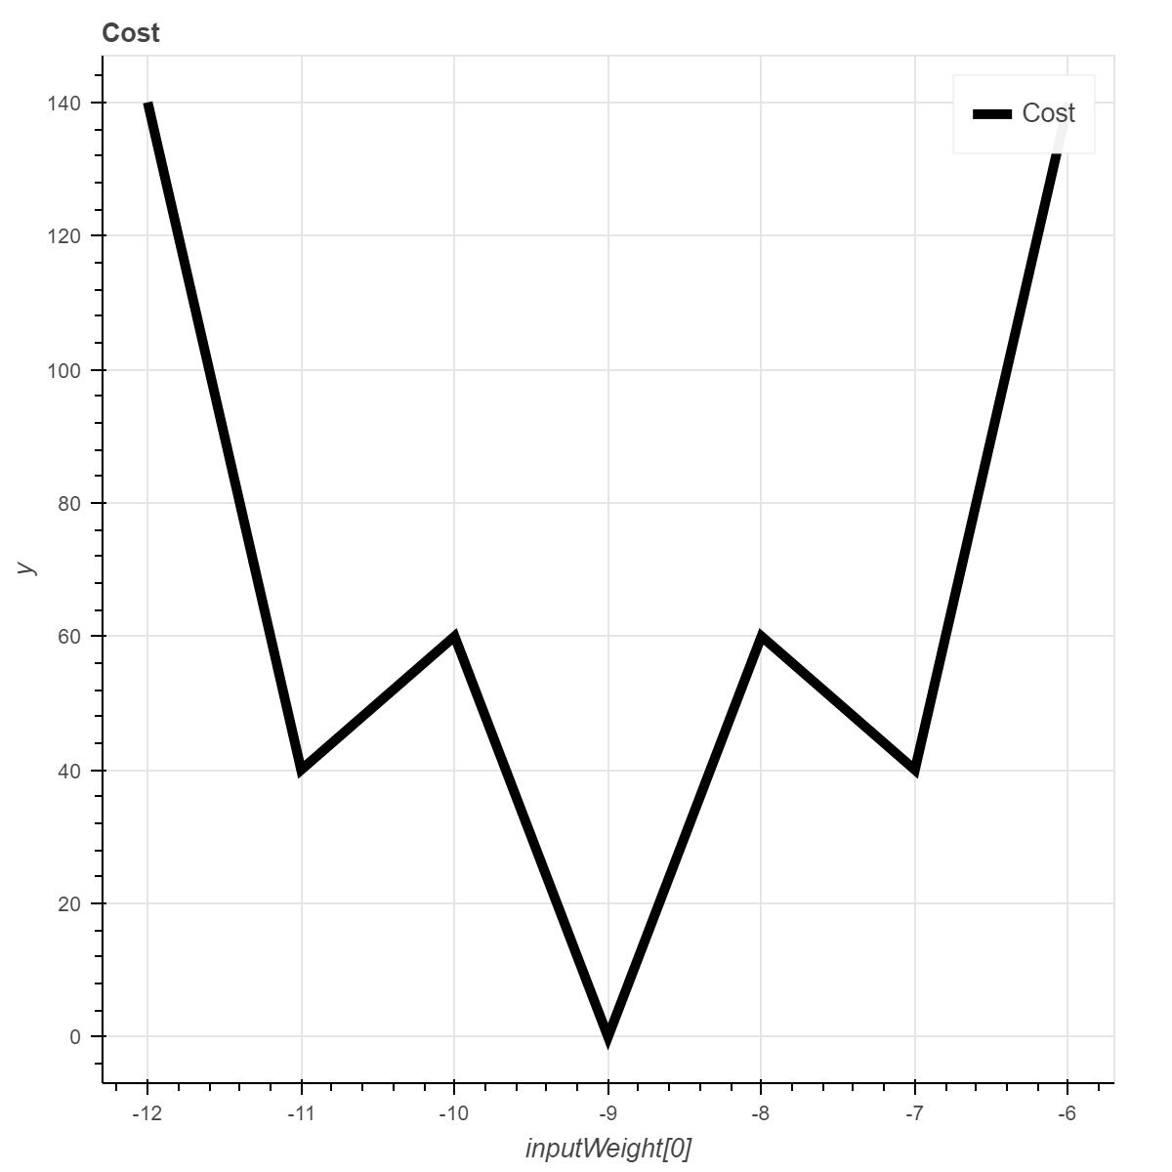
Global vs Local Minima
Many functions will have local minimums.
Luckily, our current simple linear regression heuristic and cost method define a convex function.
More complex heuristics are unlikely to produce convex results.
It is impossible to guarantee we find the global minima of an arbitrary function.
Local
Global

Slide 15

Gradient Descent
We can use the gradient descent algorithm to iteratively adjust our input weights to find a local minimum to our cost function.
repeat until convergence:
{
for each $θ_{j}$
$θ_{j}$update = $θ_{j}−α$ $\frac{∂}{∂θ_{j}}J\left(θ_{0},θ_{1}\right)$
for each $θ_{j}$
$θ_{j}$= $θ_{j}$update
}

Slide 16
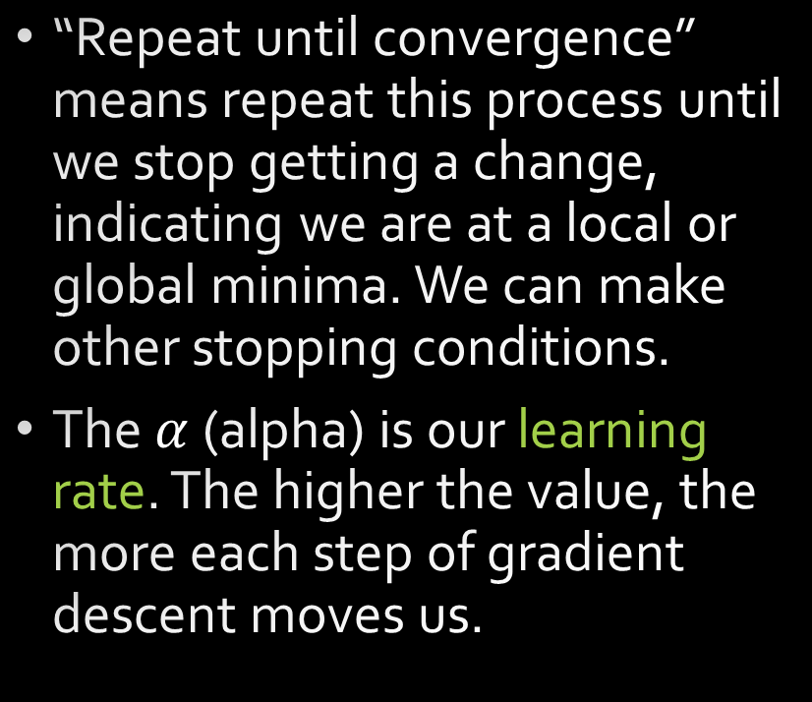

Gradient Descent
repeat until convergence
{
for each $θ_{j}$
$θ_{j}$update = $θ_{j}−α$ $\frac{∂}{∂θ_{j}}J\left(θ_{0},θ_{1}\right)$
for each $θ_{j}$
$θ_{j}$= $θ_{j}$update
}
“Repeat until convergence” means repeat this process until we stop getting a change, indicating we are at a local or global minima. We can make other stopping conditions.
The $α$ (alpha) is our learning rate. The higher the value, the more each step of gradient descent moves us.

Slide 17

Gradient Descent Pseudo-code
repeat until convergence
for numIterations
{
for each $θ_{j}$
$θ_{j}$update = $θ_{j}−α$ $\frac{∂}{∂θ_{j}}J\left(θ_{0},θ_{1}\right)$
// (Optional) Has convergence been reached?
if($θ_{j}$update == $θ_{j}$, for all values of j) break;
for each $θ_{j}$
$θ_{j}$= $θ_{j}$update
}

Slide 18
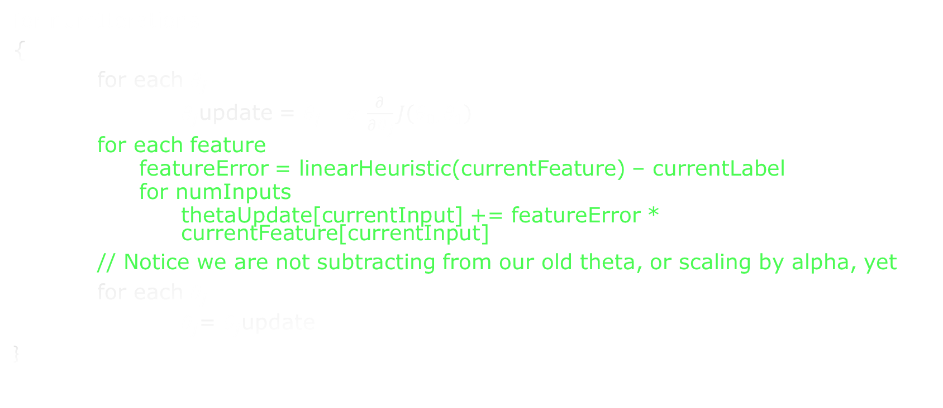
Gradient Descent Pseudo-code
for numIterations
{
for each $θ_{j}$
$θ_{j}$update = $θ_{j}−α$ $\frac{∂}{∂θ_{j}}J\left(θ_{0},θ_{1}\right)$
for each feature
featureError = linearHeuristic(currentFeature) – currentLabel
for numInputs
thetaUpdate[currentInput] += featureError * currentFeature[currentInput]
// Notice we are not subtracting from our old theta, or scaling by alpha, yet
for each $θ_{j}$
$θ_{j}$= $θ_{j}$update
}

Slide 19

Gradient Descent Pseudo-code
for numIterations
{
for each feature
featureError = linearHeuristic(currentFeature) – currentLabel
for numInputs
thetaUpdate[currentInput] += featureError * currentFeature[currentInput]
for each $θ_{j}$
$θ_{j}$= $θ_{j}$update
for numInputs
theta[currentInput] = theta[currentInput] – alpha * thetaUpdate[currentInput] / numFeatures
}

Slide 20
Gradient Descent Pseudo-code
for numIterations
{
for each feature
featureError = linearHeuristic(currentFeature) – currentLabel
for numInputs
thetaUpdate[currentInput] += featureError * currentFeature[currentInput]
for numInputs
theta[currentInput] = theta[currentInput] – alpha * thetaUpdate[currentInput] / numFeatures
}

Slide 21
Gradient Descent
If the learning rate is very small, gradient descent will have to be run many times to get a good result.
If the learning rate is too high, it can actually jump right past the local minima and get a worse answer!
We will have to adjust our number of iterations and learning rate to get the best results possible.

Slide 22
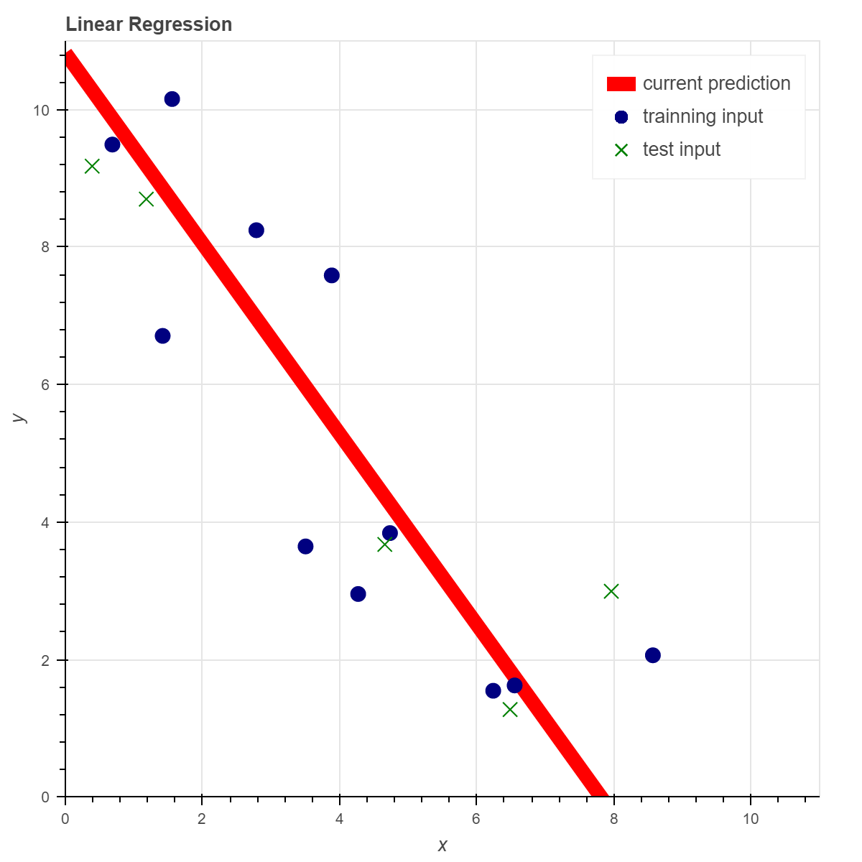
Training and testing
A portion of our data will be reserved for testing our resulting heuristic.
We will not train on this data.
We run our cost function using the test data to determine how good our heuristic will be at predicting values it was not trained on.
Commonly around 20% of data is reserved for testing.

